Slide 1
MOCK PRESENTATION AND FINAL POLISHING

Slide 2
Pyinstaller fundamentals
What is PyInstaller?
PyInstaller is a Python package that allows us to convert Python scripts (.py) into standalone executables (.exe) that can run on Windows, macOS, and Linux without requiring Python to be installed.
Why Use PyInstaller?
Removes the need for end-users to install Python and dependencies manually.
Ensures compatibility with different environments.
Simplifies software distribution.
Installing PyInstaller
pip install pyinstaller
pyinstaller --version

Slide 3
Pyinstaller fundamentals
Pyinstaller Modes
PyInstaller provides different modes for packaging applications:
One-File Mode (--onefile): Generates a single executable that extracts dependencies at runtime.
One-Folder Mode (Default): Creates a folder containing all necessary files.
Console Mode (--console): Keeps the terminal open (useful for debugging).
Windowed Mode (--windowed): Suppresses the terminal (for GUI applications).

Slide 4
Pyinstaller fundamentals
Console vs Windowed Mode
Console Mode (--console, default):
Opens a command prompt (terminal) when running the .exe.
Useful for debugging because it displays print statements and error messages.
If the program crashes, the error message remains visible.
Windowed Mode (--windowed):
Runs the application without a terminal window.
Designed for GUI applications (Tkinter, PyQt, etc.).
Suppresses error messages and print statements.
If the program crashes, it may close silently without displaying an error.

Slide 5
Pyinstaller fundamentals
CONVERTING A SCRIPT INTO EXECUTABLE
Let’s say we have a Python script called image_classifier.py
pyinstaller --onefile image_classifier.py
--onefile bundles everything into a single .exe file.
Additional PyInstaller Options
pyinstaller --onefile --icon=app_icon.ico image_classifier.py
pyinstaller --hidden-import some_module --onefile image_classifier.py
pyinstaller --console image_classifier.py
pyinstaller --windowed image_classifier.py

Slide 6
Pyinstaller fundamentals
Quiz: Applying Pyinstaller for Packing Python Apps.
Question 1: Create an .exe app using Pyinstaller with the script name “Example1.py”, which is located at D:\Software\Example1.py
cd D:\Software
pyinstaller --onefile Example.py
Question 2: Create an .exe app using Pyinstaller with the script name “Example2.py” and specific an application icon located at D:\Software\app_icon.jpg
cd D:\Software
pyinstaller --onefile --icon=D:\Software\app_icon.jpg Example2.py
Question 3: Create an .exe app using Pyinstaller with the script name “example3.py” and include a hidden import file named model.keras, which is located at D:\Software\model.keras. Use the windowed option to suppress the consolde
cd D:\Software
pyinstaller --onefile --windowed --hidden-import=model.keras example3.py

Slide 7
Pyinstaller fundamentals
Quiz: Applying Pyinstaller for Packing Python Apps.
Question 4: Create an .exe app using Pyinstaller with the script name “RS_Lab_Software.py”, and include an application icon + hidden import file. The icon and hidden import file have the same name and directory as Question 1,2 and 3. Use the windowed option and do not use compression in onefile.
cd D:\Software
pyinstaller --windowed --icon=D:\Software\app_icon.jpg --hidden-import=model.keras RS_Lab_Software.py

Slide 8
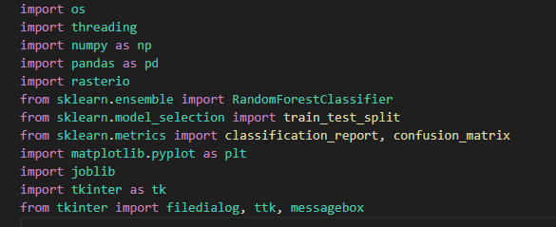
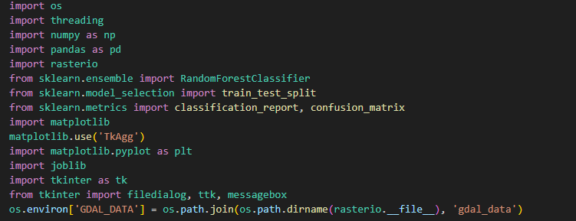
MODIFY THE GUI SCRIPT BEFORE EXECUTING PYINSTALLER

Slide 9
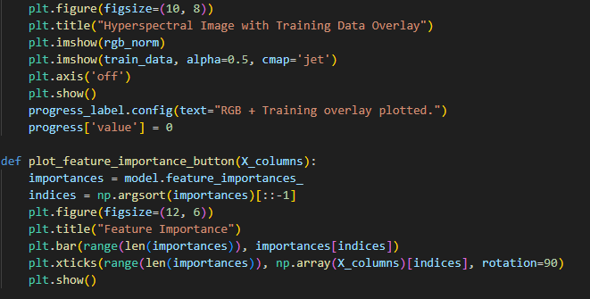
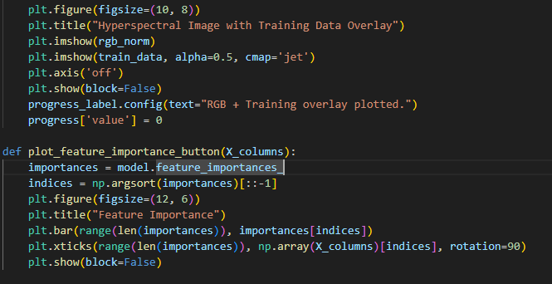
MODIFY THE GUI SCRIPT BEFORE EXECUTING PYINSTALLER

Slide 10
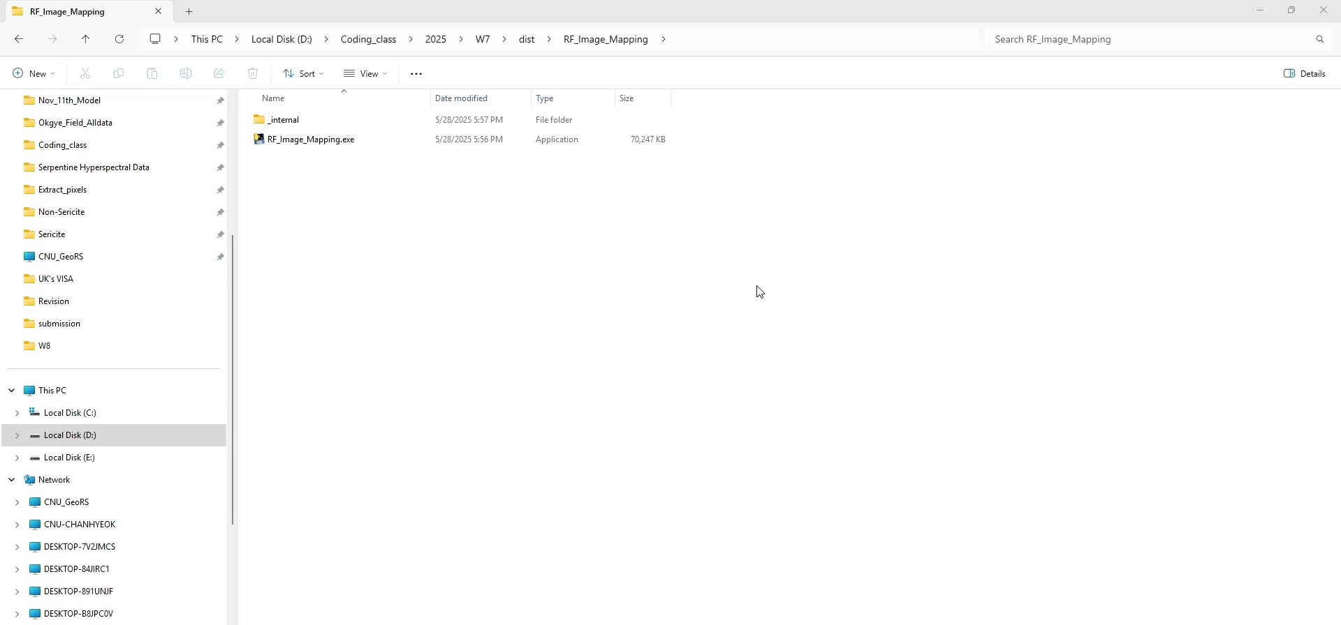
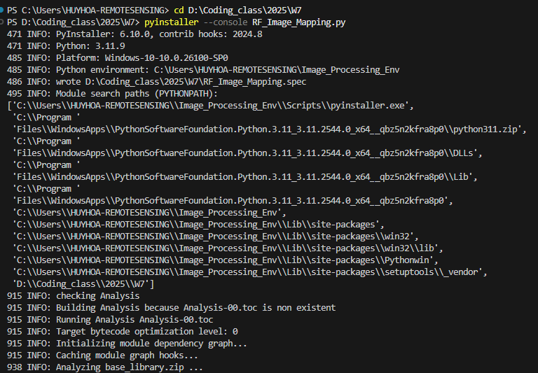
ERROR WHILE OPENING EXE FILE

Slide 11
PYINSTALLER ERROR FIX
pyinstaller RF_Image_Mapping_GUI.py --noconfirm --console --collect-submodules rasterio

Slide 12
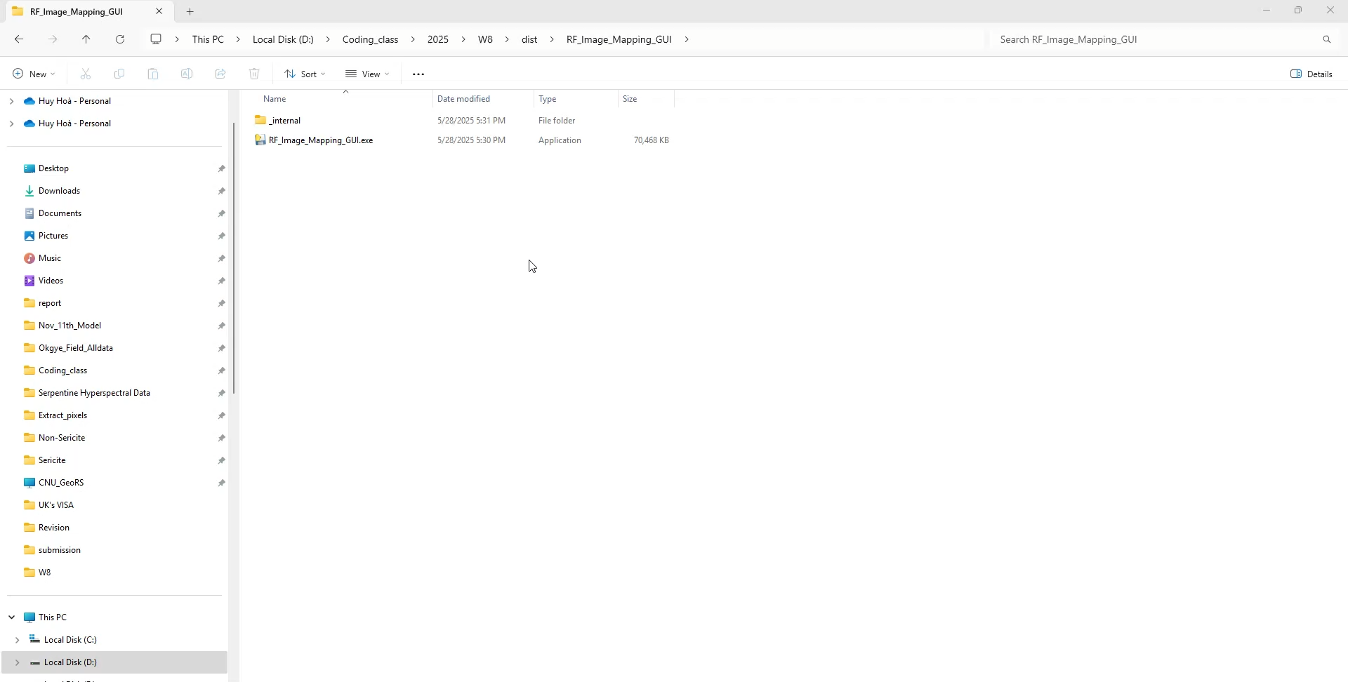
ERROR WITH PLOTTING

